Slide 1
ASP.NET Controls
IT533 Lecture

Slide 2
Installations
Microsoft® SQL Server® 2008 Express

Slide 3
Server Controls
ASP.NET ships with ~50 built-in controls
Organized into logical families
  HTML controls
    Controls / properties map 1:1 with HTML
  Web controls
    Richer functionality
    More consistent object model

Slide 4
Server Controls
HTML Controls
Works well with existing HTML designers
Properties map 1:1 with HTML
    table.bgcolor ="red“;
Can specify client-side event handlers
Good when quickly converting existing pages
Derived from System.Web.UI.HtmlControls.HtmlControl
Supported controls have custom class, others derive from HtmlGenericControl

Slide 5
Server Controls
HTML Controls
Supported controls
  <a>
  <img>
  <form>
  <table>
  <tr>
  <td>
  <th>
  <select>
  <textarea>
  <button>
  <input type=text>
  <input type=file>
  <input type=submit>
  <input type=button>
  <input type=reset>
  <input type=hidden>

Slide 6
Server Controls
HTML Controls
Demo 1: HTMLControls1.aspx
  Basic page lifecycle with HTML Controls
Demo 2: HTMLControls2.aspx
  More HTML Controls

Slide 7
Server Controls
HTML Controls
Can use controls two ways:
  Handle everything in action events (e.g. button click)
    Event code will read the values of other controls (e.g. text, check boxes, radio buttons, select lists)
  Handle change events as well as action events

Slide 8
Server Controls
Web Controls
Consistent object model
  Label1.BackColor = Color.Red;
  Table.BackColor = Color.Blue;
Richer functionality
  E.g. AutoPostBack, additional methods
Strongly-typed; no generic control
  Enables better compiler type checking

Slide 9
Server Controls
Web Controls
Web controls appear in HTML markup as namespaced tags
Web controls have an asp: prefix
<asp:button onclick="button1_click“ runat=server>
<asp:textbox onchanged="text1_changed“ runat=server>
Defined in the System.Web.UI.WebControls namespace
This namespace is automatically mapped to the asp: prefix

Slide 10
Server Controls
Web Controls
Web Controls provide extensive properties to control display and format, e.g.
  Font
  BackColor, ForeColor
  BorderColor, BorderStyle, BorderWidth
  Style, CssClass
  Height, Width
  Visible, Enabled

Slide 11
Server Controls
Web Controls
Four types of Web Controls
  Intrinsic controls
  List controls
  Rich controls
  Validation controls

Slide 12
Server Controls
Intrinisic Controls
Correspond to HTML controls
Supported controls
  <asp:button>
  <asp:imagebutton>
  <asp:linkbutton>
  <asp:hyperlink>
  <asp:textbox>
  <asp:checkbox>
  <asp:radiobutton>
  <asp:image>
  <asp:label>
  <asp:panel>
  <asp:table>

Slide 13
Server Controls
Intrinisic Controls
TextBox, ListControl, CheckBox and their subclasses don’t automatically do a postback when their controls are changed
Specify AutoPostBack=true to make change events cause a postback

Slide 14
Server Controls
List Controls
Controls that handle repetition
Supported controls
  <asp:dropdownlist>
  <asp:listbox>
  <asp:radiobuttonlist>
  <asp:checkboxlist>
<asp:repeater>
<asp:datalist>
<asp:datagrid>
Repeater, DataList and DataGrid controls expose templates for customization
  More about these controls and templates later

Slide 15
Server Controls
CheckBoxList & RadioButtonList
Provides a collection of check box or
radio button controls
Can be populated via data binding
  <asp:CheckBoxList id=Check1 runat="server">
  <asp:ListItem>Item 1</asp:ListItem>
  <asp:ListItem>Item 2</asp:ListItem>
  <asp:ListItem>Item 3</asp:ListItem>
  <asp:ListItem>Item 4</asp:ListItem>
  <asp:ListItem>Item 5</asp:ListItem>
  </asp:CheckBoxList>

Slide 16
Server Controls
Intrinisic & Simple List Controls
Demo 1: WebControls1.aspx
  Assorted intrinsic and list controls
Demo 2: WebControls2.aspx
  Same controls with AutoPostBack

Slide 17
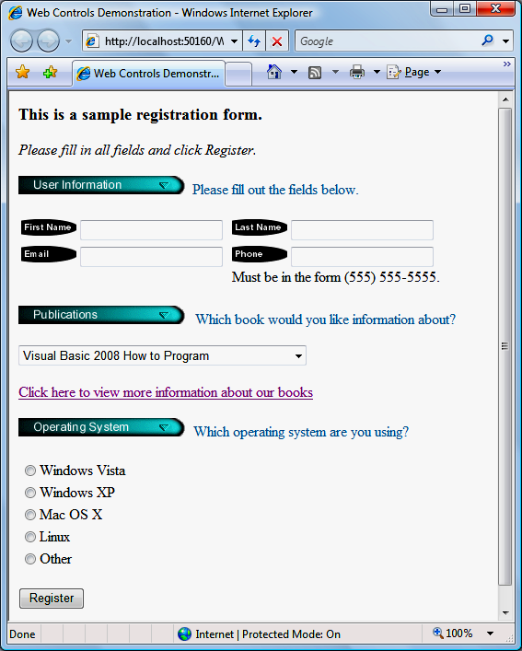
WebControls3 Example
Image control
TextBox control
DropDownList control
HyperLink control
RadioButtonList
Button control

Slide 18
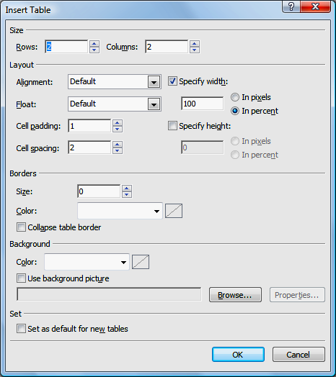
WebControls3 Example
We will generate this page by Visual Studio’s Design mode.
• Create an ASP.NET Web Site named WebControls3.
• Add an h3 heading element.
• Add an XHTML table element to organize the Image and TextBox controls in the user-information section of the page.
  Select Insert Table from the
    Table menu to display the
    Insert Table dialog
  In the Size group box, change
    the values of Rows and Columns
    to 2.

Slide 19
WebControls3 Example
Change the vertical alignment of all cells in the table (i.e., td elements) by setting the valign property to top in the Properties window.
Also change the width of the cells in the left column by modifying the style property in the Properties window.
  Click the ellipsis next to the style property to display the Modify Style dialog.
  Set the width (in the Position category) to 225px.

Slide 20
WebControls3 Example
Add an Image control to insert an image.
Add an Images folder to this project by right clicking the location of the project in the Solution Explorer and selecting New Folder.
Then add each of the images used in the example to this folder by right clicking the folder and selecting Add Existing Item….
The ImageUrl property specifies the location of the image to display.
To select an image, click the ellipsis next to the ImageUrl property and use the Select Image dialog.
A TextBox control allows you to obtain text from the user and display text to the user.

Slide 21
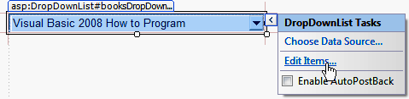
WebControls3 Example
A DropDownList does not allow users to type text.
Each item in the drop-down list is defined by a ListItem element.
You can add items to a DropDownList using the ListItem Collection Editor. This process is similar to customizing a ListBox in a Windows application.
Visual Studio displays smart-tag menus for many ASP.NET controls to facilitate common tasks.

Slide 22
WebControls3 Example
Add a HyperLink control.
The Navigate­Url property of this control specifies the resource that is requested when a user clicks the hyperlink.
Setting the Target property to _blank specifies that the requested web page should open in a new window or tab.
The RadioButtonList control provides a series of radio buttons from which the user can select only one.
Like options in a DropDownList, individual radio buttons are defined by ListItem elements.
A Button web control represents a button that triggers an action when clicked, and typically maps to an XHTML input element of type "button".

Slide 23
WebControls3 Example: CSS Styling
CSS Inline Styles and Embedded Style Sheets
Visual Web Developer often generates CSS (Cascading Style SheetsTM) code to specify the presentation of an element.
In the head element of your .aspx file, the style element
defines embedded style sheets.
The style element’s type attribute specifes the MIME type
of its content.
The body of the style sheet declares CSS rules (styles).
A CSS rule is composed of a CSS selector and a series of property specifications separated by semicolons (;) and enclosed in curly braces ({}).
Each specification is composed of a property followed by a
colon and a value.

Slide 24
WebControls3 Example: CSS Styling
Setting the Color of Text on a Web Form
Add CSS styles using <style>
Then apply the style in an XHTML span element using CSS styling.
The style class can then be applied to any element in the document by setting the XHTML attribute class.
Another way to apply styles is to use inline styles, which declare an individual element’s format using the XHTML attribute style.

Slide 25
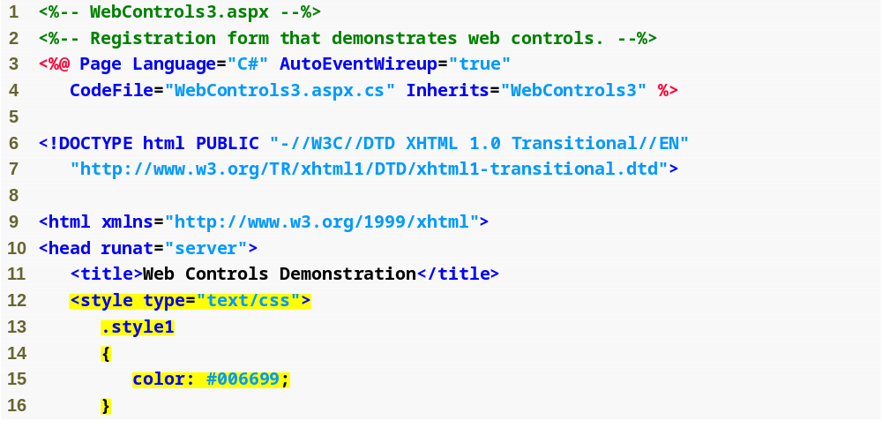
Simple form for gathering user input
Outline
WebControls.aspx
( 1 of 6 )
In the head element of your .aspx file, the style element defines embedded style sheets.
Web Form that demonstrates web controls. (Part 1 of 6. )

Slide 26
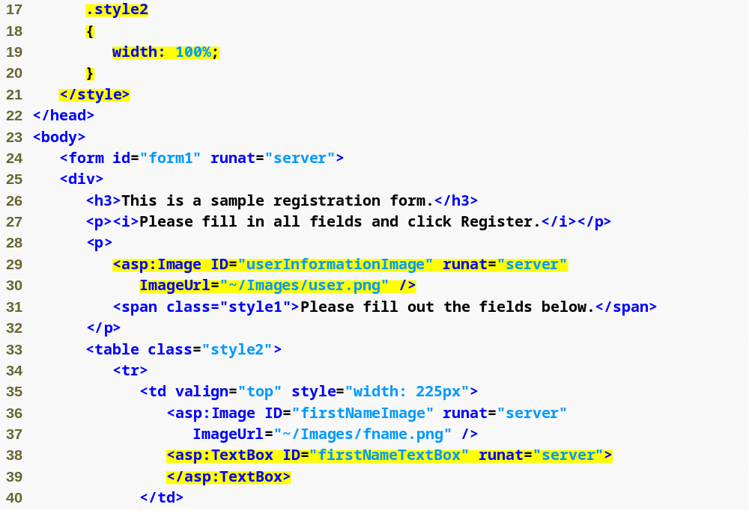
In the head element of your .aspx file, the style element defines embedded style sheets.
An Image control inserts an image into a web page.
A TextBox control allows you to obtain text from the user and display text to the user.
Fig. | Web Form that demonstrates web controls. (Part 2 of 6. )

Slide 27
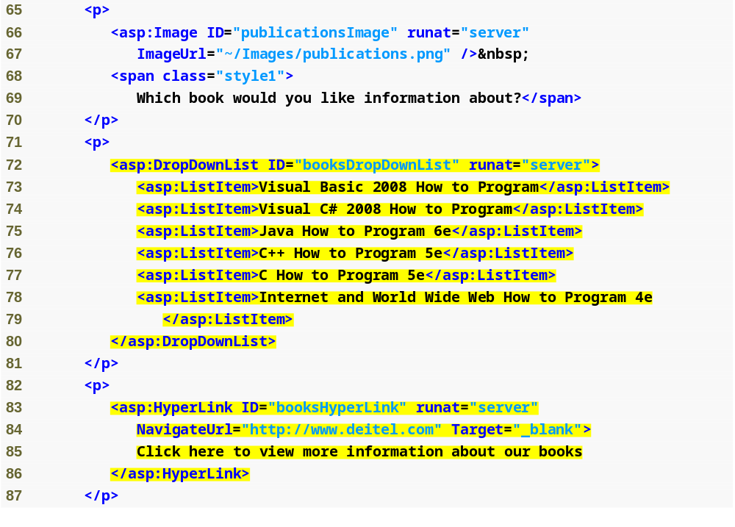
The DropDownList control provides a list of values from which the user can select only one.
The HyperLink control adds a hyperlink to a web page.
Fig. | Web Form that demonstrates web controls. (Part 4 of 6. )

Slide 28
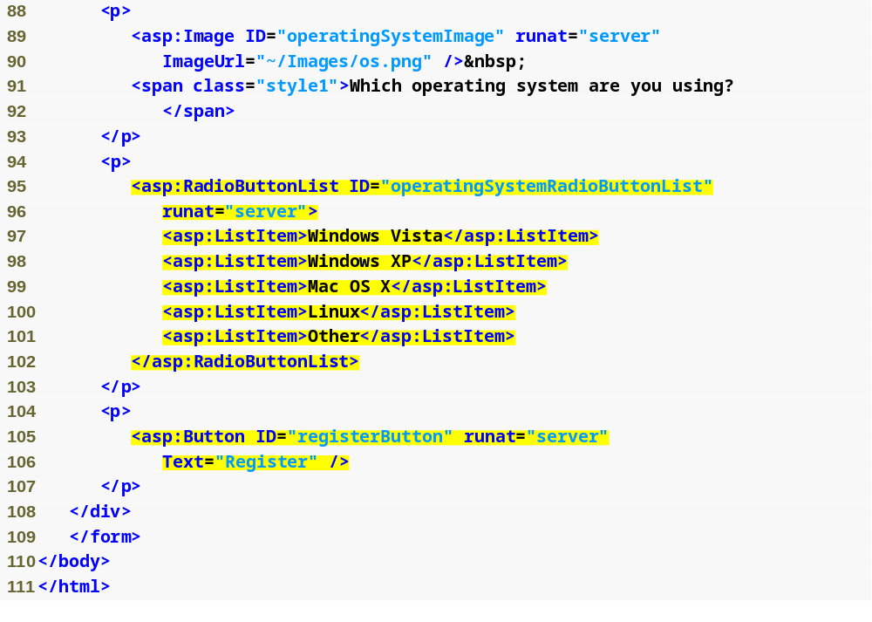
The RadioButtonList control provides a series of radio buttons from which the user can select only one.
A Button web control represents a button that triggers an action when clicked, and typically maps to an XHTML input element of type "button".
Fig. | Web Form that demonstrates web controls. (Part 5 of 6. )

Slide 29
Server Controls
Rich Controls
Custom controls with rich functionality
Supported Controls
  <asp:calendar>
  <asp:adrotator>
More will be added
3rd party controls (http://www.telerik.com/ )
Demo: RichControls1.aspx

Slide 30
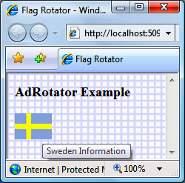
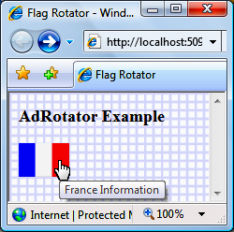
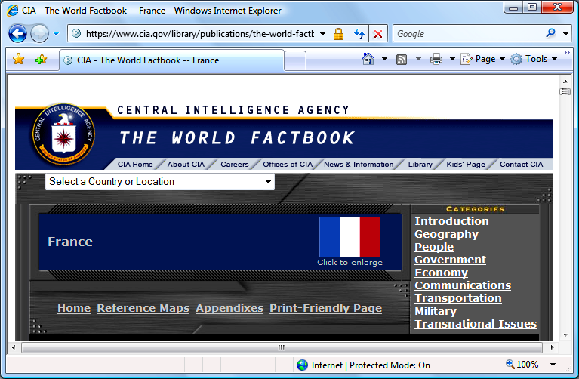
a)
b)
Outline
FlagRotator.aspx
(3 of 3 )
AdRotator image
AlternateText
displayed in a tool tip
c)
Fig. | Web Form that demonstrates the AdRotator
web control. (Part 3 of 3. )

Slide 31
AdRotator Example: FlagRotator
Add an AdRotator control named countryRotator.
Add a XmlDataSource control, which supplies the data to the AdRotator control.
Figure (a) shows the first time the page is requested, when the Swedish flag is randomly chosen.
In the second request, as shown in Figure (b), the French flag is displayed.
Figure (c) depicts the web page that loads when you click the French flag.

Slide 32
AdRotator Example: FlagRotator
Connecting Data to an AdRotator Control
An XmlDataSource references an XML file containing data that will be used in an ASP.NET application.
To build this example, we first add the XML file AdRotatorInformation.xml to the project.
Right click the App_Data folder in the Solution Explorer and select Add Existing Item….
Next, drag an AdRotator control from the Toolbox to the Web Form.

Slide 33
AdRotator Example: FlagRotator
From the smart-tag menu, select <New Data Source…> from the Choose Data Source drop-down list to start the Data Source Configuration Wizard.
Select XML File as the data-source type. Set the ID of the control to adXmlDataSource.
In the next dialog’s Data File section, click Browse… and, in the Select XML File dialog, locate and select the XML file you added to the App_Data folder.

Slide 34
AdRotator Example: FlagRotator
Examining an XML File Containing Advertisement Information
Any XML document used with an AdRotator control— must contain one Advertisements root element.
Within that element can be as many Ad elements as you need. Each Ad element is similar to the following:
<Ad>
<ImageUrl>Images/france.png</ImageUrl>
<NavigateUrl>https://www.cia.gov/library/publications/
the-world-factbook/geos/fr.html
</NavigateUrl>
<AlternateText>France Information</AlternateText>
<Impressions>1</Impressions>
</Ad>

Slide 35
AdRotator Example: FlagRotator
Element ImageUrl specifies the path (location) of the advertisement’s image.
Element NavigateUrl specifies the URL for the web page that loads when a user clicks the advertisement.
The AlternateText element nested in each Ad element contains text that displays in place of the image when the browser cannot display the image.
The Impressions element specifies how often a particular image appears, relative to the other images. In our example, the advertisements display with equal probability, because the value of each Impressions element is set to 1.

Slide 36
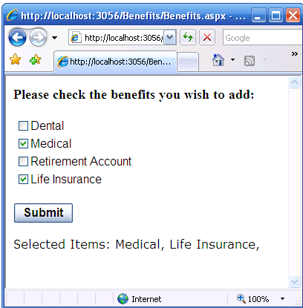
Exercise

